Slide 1
How does the web work?
The browser sends an HTTP request message to the server, asking it to send a copy of the website to the client (you go to the shop and order your goods). This message, and all other data sent between the client and the server, is sent across your internet connection

Slide 2
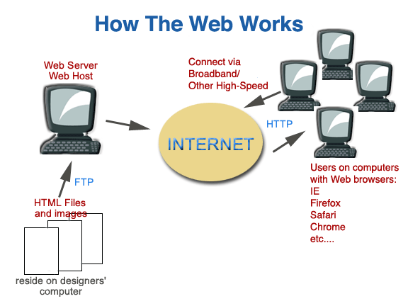

Slide 3
What do you need to be a web developer?
To become a Web Developer, you should have an understanding of HTML, CSS, and JavaScript. It’s also recommended to learn about CSS and CSS frameworks. Developing these fundamental web development skills will give you the foundation and logic for communicating with programming languages.

Slide 4
Why did you choose to learn web development?
Web development gives me the opportunity to express myself creatively on the internet. If i have an idea, I would like to try as I discover my web dev skills, try it out. Web dev is a fun, creative experience.

